Slide 1
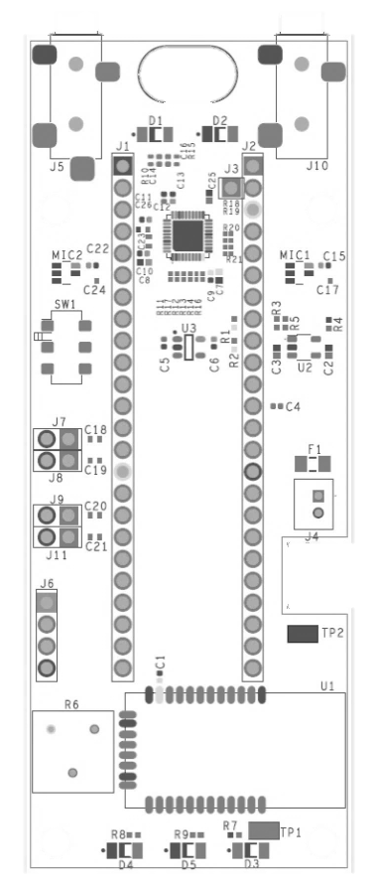


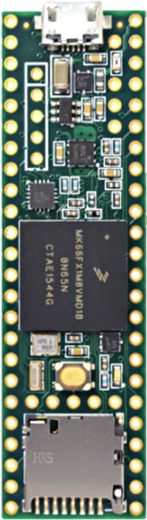

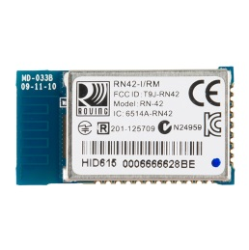
One Concept for Packaging
Section A
Section B
Top Cover
Top Cover
Screws
Optional Sides
INPUT
PHONES
INPUT
PHONES
Start Bulge
Screw
Screw
Section A
Bottom Cover
Bottom Cover
RIGHT
LEFT
RIGHT
LEFT
Section B
ON
Section C
Section D
ON
Section C
OFF
OFF
Wiring
Section D
BATT
BATT
Battery Bulge
Battery Bulge
1.8V
1.8V
MISO
MISO
SCLK
SCLK
GND
GND
Section E
Section E
Section F
3.3V
RN-42
RN-42
A1
AGND
3.3V
A1
AGND
Section F
Screws
TYMPAN A
TYMPAN A
Bluetooth Bulge
LED Bulge
Screw
Screw
End Bulge
Translucent Cover

Slide 2
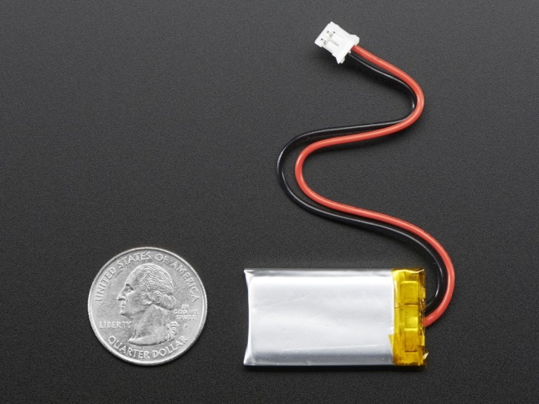
Battery
At Minimum, we need to fit this battery underneath
Lithium Ion Polymer Battery - 3.7v 350mAh
https://www.adafruit.com/products/2750
Dimensions: 36mm x 20mm x 5.6mm / 1.4" x 0.8" x 0.22
Ideally, we’d also leave space to enable us to swap in either of these bigger ones:
Lithium Ion Polymer Battery - 3.7v 500mAh
https://www.adafruit.com/products/1578
Size: 29mm x 36mm x 4.75mm / 1.15" x 1.4" x 0.19"
Lithium Ion Polymer Battery - 3.7v 500mAh
https://www.adafruit.com/products/258
Dimensions: 34mm x 62mm x 5mm / 1.3" x 2.4" x 0.2"

